Slide 1
Delay of flights in American
Chengxiang Xiao

Slide 2
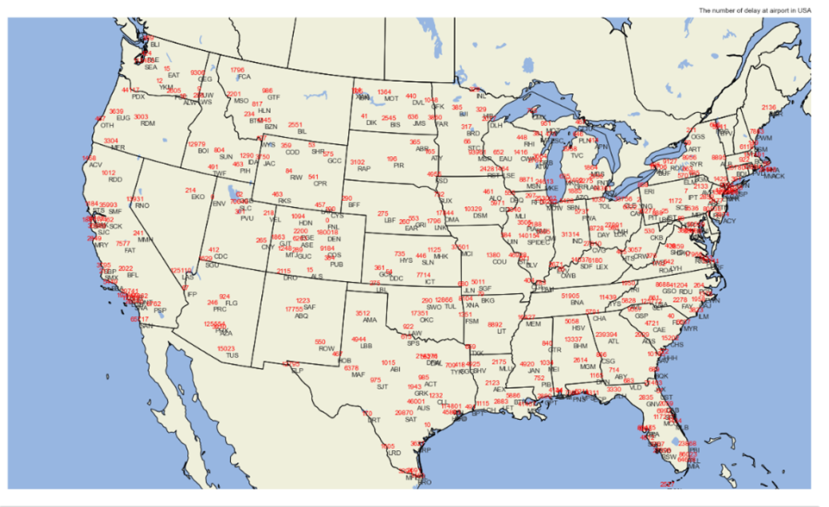
The station plot for total number of delay airplane base on airport
The plot is using the surface station plot on metpy. The station plot is based the longitude and altitude of the airport.
There are 380 airports in the American.
27 Airports in Texas, and SAT have total 29870 delays happened from Jan 2015 to Feb 2021.

Slide 3
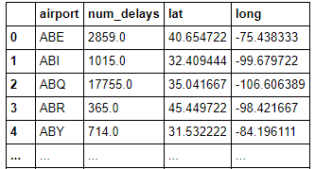
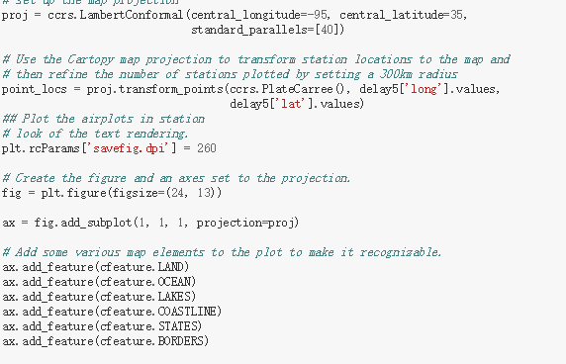
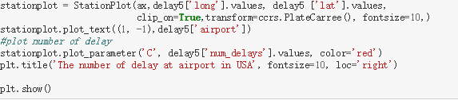
Coding in Metpy
The coding take 3 steps
1, Extract data from original data set re- frame and merge with airports name and coordinate
Old dataset(87860,22)
New dataset(380 x4)
2, Setting for metpy and add position point on the USA map.
3, Plot the name of the airports and the value of delay based on coordinate,

Slide 4
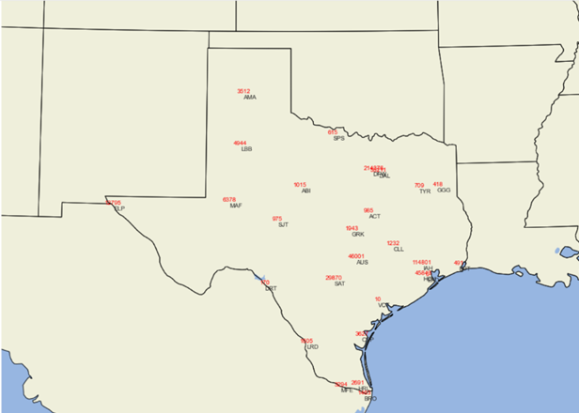
The station plot for delay flight in Texas.
1,The Texas has 27 airports.
2, The largest number of delay airport is
DFW. The total delay number in the
past 5 years is 214376.
3,The SAT is the 6th larger number delay
in Texas.

Slide 5
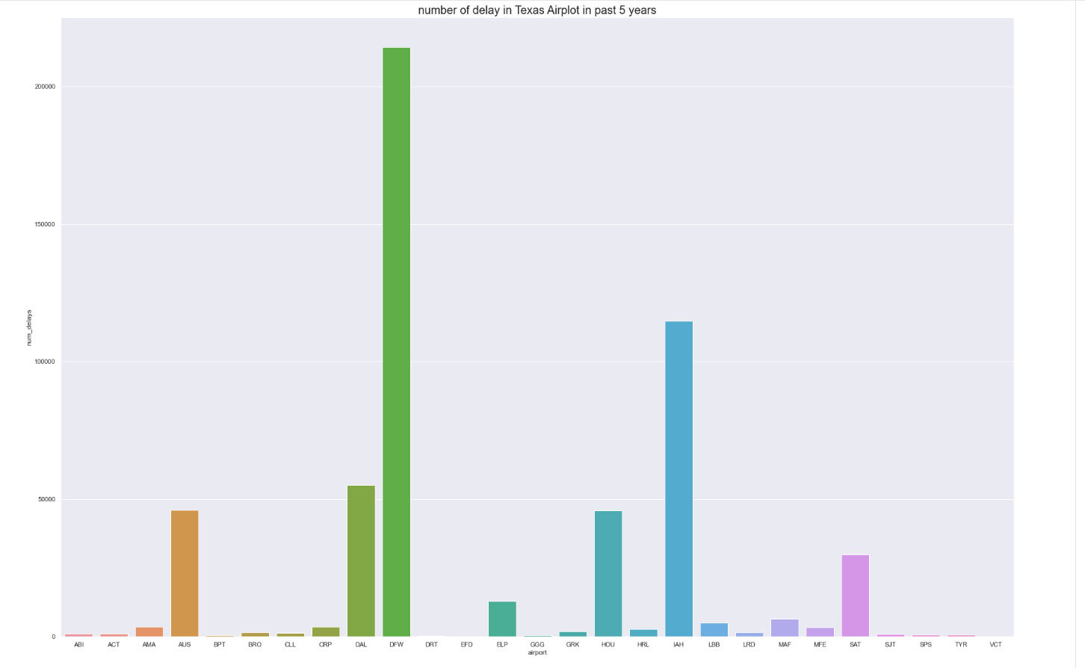
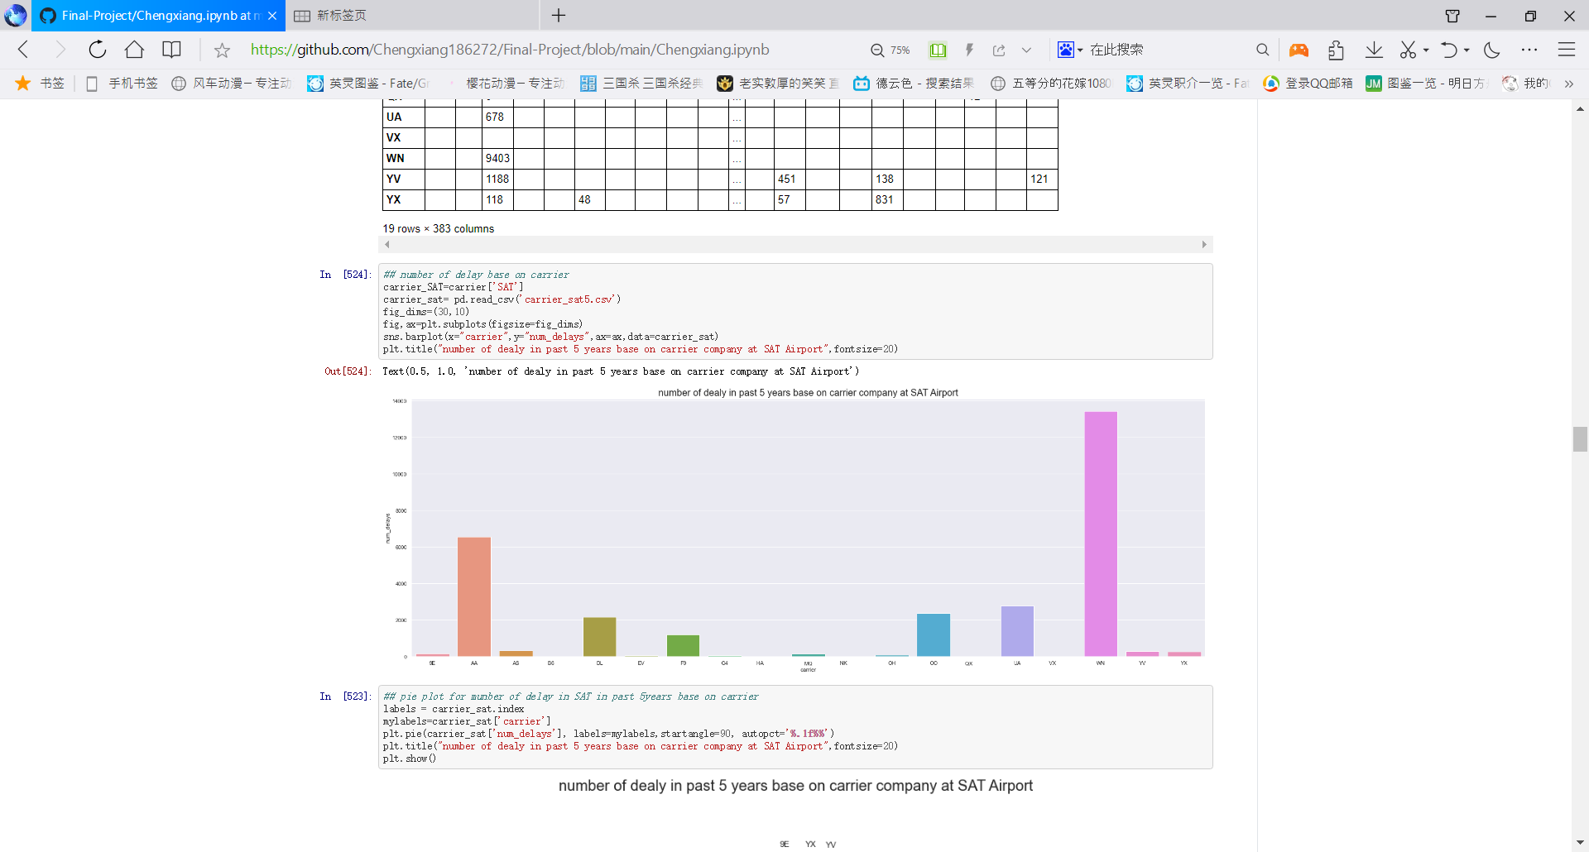
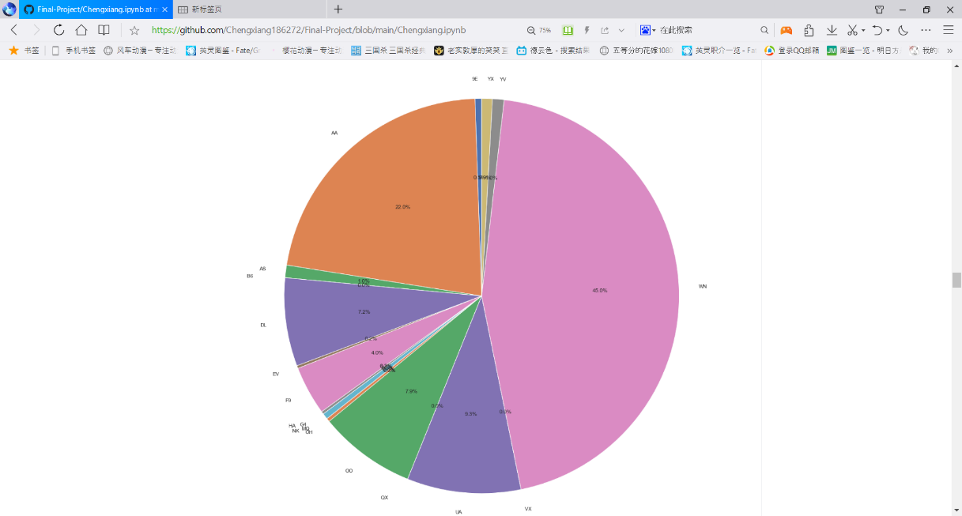
Histogram plot
Right upper figure shows the total number of delay flight in Texas base on airport.
Fight delay base on carrier company at SAT. SW, AA has the largest total number of delay which take 45% and 22%.
These plots are generating from matplotlib.

Slide 6
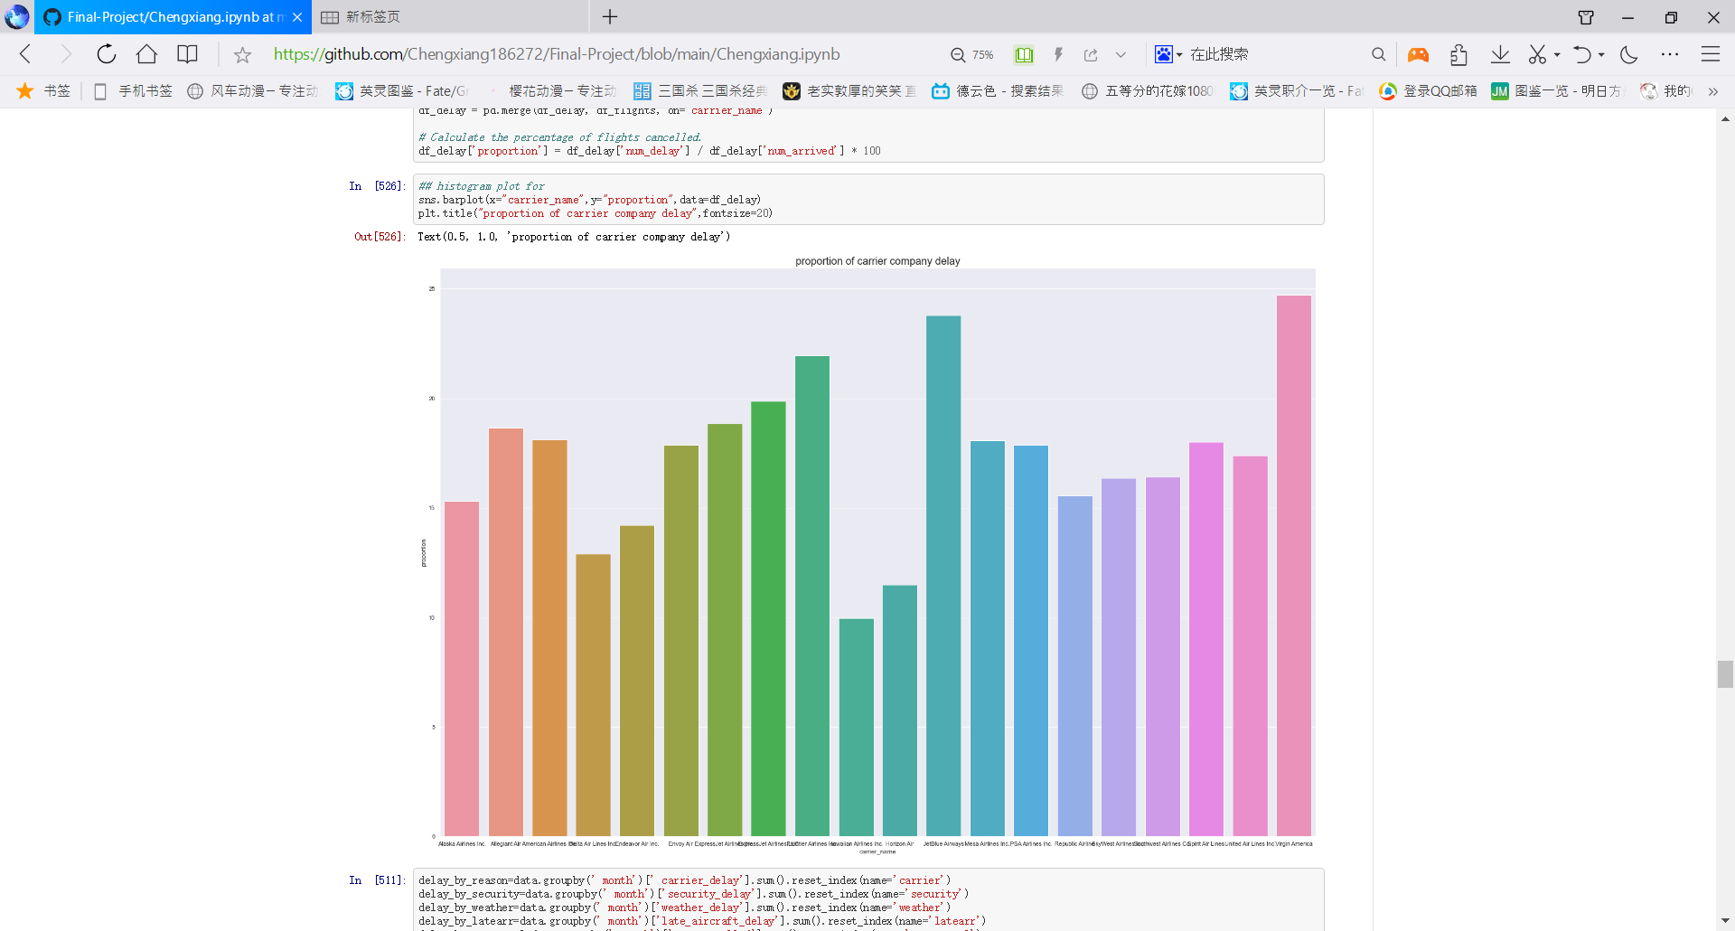
Histogram plot
The right figure shows the number of delay fight base on carrier company
In whole American.
The right figure shows the proportion of the fight delay base on carrier company. The proportion is calculate by total number of delay/ total number arrival.

Slide 7
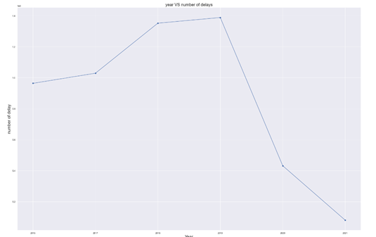
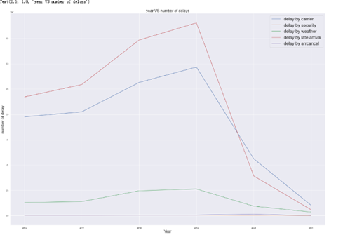
Line plot
The figure shows the number of delay change by years. It was increasing from 2015 to 2019. But due to the covid-19 breakout, the number of delay flights decrease rapidly at 2020.

Slide 8
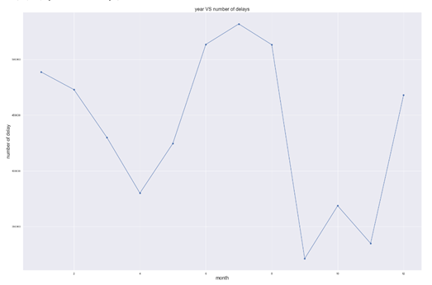
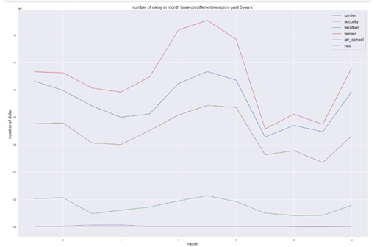
Line plot base on month
The plot show there is a seasonal change for delay flight. In summer and winter, the delay is much larger than spring and autumn.
There is also a same seasonal change on weather, late arrival, carrier reason delay.

Slide 9
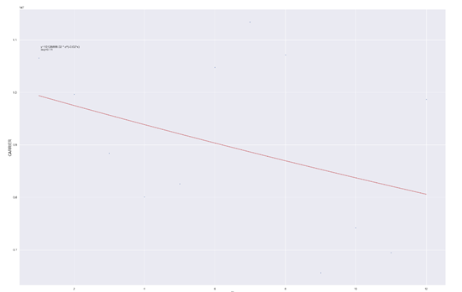
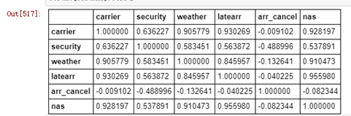
Linear regression and correction
Linear regression did not show to much comparing the monthly change, with small dataset.
The reason for delay, carrier, weather, late arrival, nation airspace system have stronger correction.

Slide 10
Thanks

Slide 11
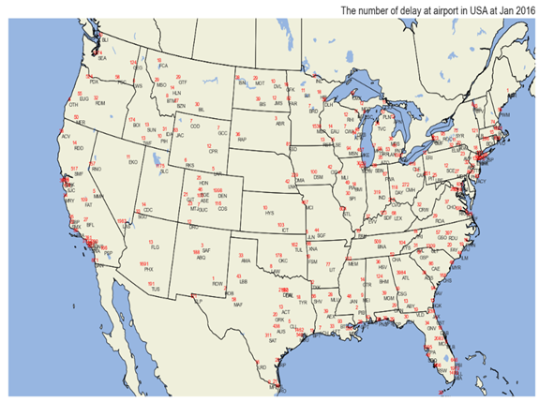
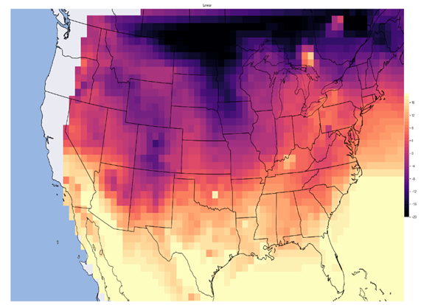
Backup slide
Show the number of delay on Jan 2016 and temperature at Jan 2016. The temperature plot is using interpolation grid base on the station temperature.

